Slide 2
Lesson 4: Implementation (12hrs)
Programming and Development Process
Mapping Design to Code
Creating Class Definitions from Design Class Diagrams
Creating Methods from Collaboration Diagram
Updating Class Definitions
Classes in Code
Exception and Error handling

Slide 3
Lesson 4: Implementation (12hrs)
The Analysis phase ends with finding out:
the Essential Use Cases that identifies the domain processes
the Conceptual or Domain Model that identifies the concept classes or terms existing in the domain
the System Sequence Diagram that shows the system events and operations and contracts that shows what the system operations do.
the Contracts that helps in documenting the expected behavior of the system.
The Design phase ends with finding out:
the Design class diagram that describes the statical structure of the system along with attributes and operations
the Interaction diagram that illustrates the dynamic aspects of the system

Slide 4
Implementation
In UP terms, there exists an Implementation Model.
This is all the implementation artifacts, such as the source code, database definitions, JSP/XML/HTML pages, and so forth.
Thus, the code being created in this chapter can be considered part of the UP-Implementation Model.
A strength of OOA/D and OO programming—when used with the UP—is that they provide an end-to-end roadmap from requirements through to code.

Slide 5
Programming and Development Process
The results generated during design modeling are an incomplete first step;
During programming and testing, numerous changes will be made and detailed problems will be uncovered and resolved.
Expect and plan for lots of change and deviation from the design during programming.
That's a key and pragmatic attitude in iterative and evolutionary methods.
Iterative and incremental development process results in the feeding of prior iteration into the beginning of next iteration, continuously refining the implementation works.

Slide 6
Programming and Development Process
The creation of code in an OO language such as Java or C# is not part of OOA/D, it's an end goal.
The artifacts created in the Design Model, the interaction diagrams and DCDs provide some of the information necessary to generate the code.
This OOAD acts as roadmap providing a starting point for experimentation and discussion of the system.

Slide 7
Creativity and Change during Implementation
Some decision-making and creative work, are accomplished during design work.
However, the programming work is not a trivial code generation step—quite the opposite.
Realistically, the results generated during design are an incomplete first step; during programming and testing, numerous changes will be made, and detailed problems will be uncovered and resolved.
The design artifacts provide a strong principal that scales up with elegance and robustness to meet the new problems encountered during programming.
Hence, expect and plan for change and deviation from the design during programming.

Slide 8
Code Changes and the Iterative Process
A strength of an iterative and incremental development process is that the results of a prior iteration can feed into the beginning of the next iteration.
Thus, subsequent analysis and design results are continually being refined and enhanced from prior implementation work.
For example, when the code in iteration N deviates from the design of iteration N (which it inevitably will), the final design based on the implementation can be input to the analysis and design models of iteration N+1.
An early activity within an iteration is to synchronize the design diagrams; the earlier diagrams of iteration N will not match the final code of iteration N, and they need to be synchronized before being extended with new design results.

Slide 9
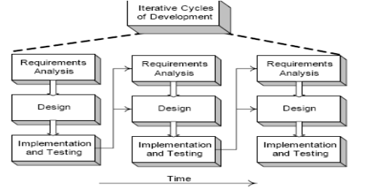
Code Changes and the Iterative Process

Slide 10
Code Changes, CASE Tools, and Reverse-Engineering
It is desirable for the diagrams generated during design to be semi-automatically updated to reflect changes in the subsequent coding work.
Ideally this should be done with a CASE tool (like Rational Rose) that can read source code and automatically generate, for example, package, class, and sequence diagrams.
This is an aspect of reverse-engineering—the activity of generating diagrams from source (or sometimes, executable) code.

Slide 11
Mapping Design to Code
It involves the implementation of object-oriented design into the object-oriented programming code.
It requires writing code for:
Class and interface definitions
Method definitions
Class definitions are created by mapping design class diagrams to code.
Method definitions are created by mapping interaction diagrams to code.

Slide 12
Creating Class Definitions from DCDs
Defining a Class with Methods and Simple Attributes
public class SaleLineItem {
private int quantity;
private ProductDescription description;
public Money getSubTotal() {…}
public SaleLineItem(ProductDescription description, int quantity) {…} }
ProductDescription
SaleLineItem
description
-description : text
-price : money
-itemID : itemID
-quantity : integer
*
describes
1
+getSubTotal() : money

Slide 13
Creating Class Definitions from DCDs
Defining a Class with Methods and Simple Attributes
public SaleLineItem(ProductDescription description, int quantity) {…}
The Java Constructor public SalesLineItem(ProductDescription desc,int qty) is created from the create(desc,qty) message sent to SalesLineItem in the enterItem interaction diagram.

Slide 14
Creating Class Definitions from DCDs
Adding Reference Attribute
private ProductDescription description;
A reference attribute is an attribute that refers to another complex object, not to a primitive type such as a String, Number, and so on. (i.e. and object as an attribute of another object).
For example, a SalesLineItem has an association to a ProductDescription, with navigability to it.
This is a reference attribute in class SalesLineItem that refers to a ProductDescription instance although we have added an instance field to the definition of SalesLineltem to point to a ProductDescription, it is not explicitly declared as an attribute in the attribute section of the class box.

Slide 15
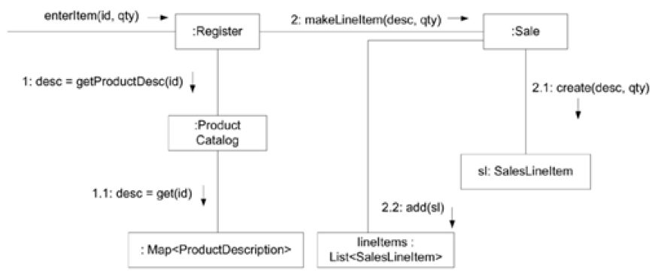
Creating Methods from Collaboration Diagram

Slide 16
Creating Methods from Collaboration Diagram
The enterItem message is sent to a Register instance so the enterItem method is defined in the Register class.
public void enterItem(ItemID itemID, int qty)
Message 1: A getProductDescription message is sent to the ProductCatalog to retrieve ProductDescription
ProductDescription desc = catalog.getProductDescription(itemID);
Message 2: A makeLineItem message is sent to the Sale
currentSale.makeLineItem (desc,qty);

Slide 17
Creating Methods from Collaboration Diagram
Hence the code looks like
public void enterItem(ItemID itemID, int qty) {
ProductDescription desc = catalog.getProductDescription(itemID);
currentSale.makeLineItem (desc, qty);
}

Slide 18
Practice Design to Code
ProductCatalog
…
catalog
+getDescription(…)
Register
1
…
Sale
+endSale()
+enterItem(id : itemID, qty : integer)
+makePayment(cashTendered : money)
-date: DateTime
-isComplete:Boolean
currentSale
1
+becomeComplete() +makeLineItem(…) +getTotal() : Money

Slide 19
Practice Design to Code
The code looks like
public class Register {
private ProductCatalog catalog;
private Sale currentSale;
public Register(ProductCatalog pc, Sale sale) {…}
public void endSale();
public void enterItem(ItemID Id, int qty) {…}
public void makePayment(Money cashTendered) {…}
}

Slide 21
PREVIEW FOR LECTURE 16
ERROR HANDLING

